Slide 1
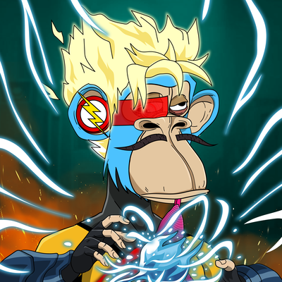
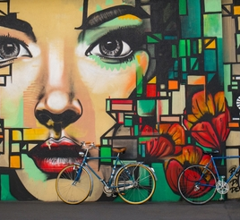
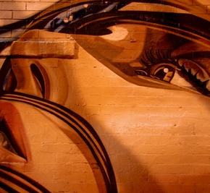
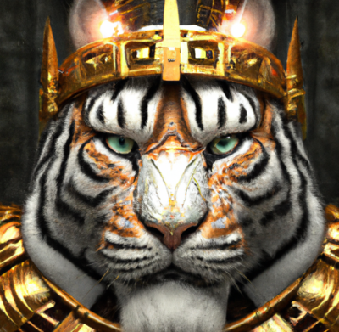
MEET THE TEAM
Declain Morndin
Joanne Mannuella
Maggie Zhan
Parvinder S Rakhra
Chief Technical Officer
Chief Executive Officer
Chief Operations Officer
Chief Strategy Officer

Slide 2
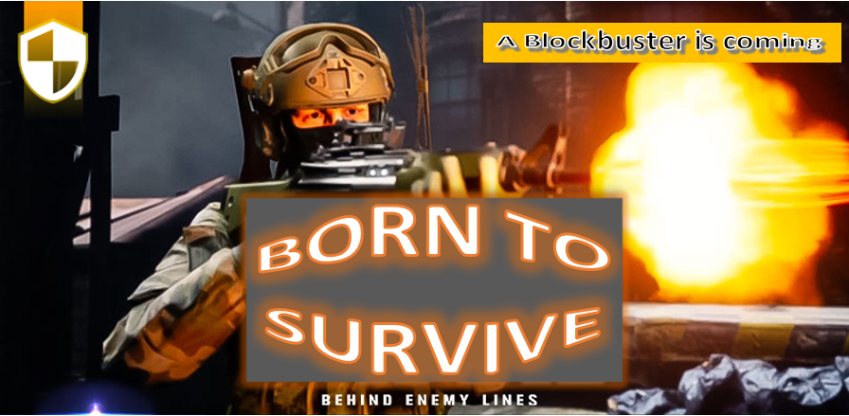
Born to survive
Play-to-earn, Blockchain game
Group 2 Presents:
Notes:
For this project we have come-up with a best in Class – AAA Blockchain Video game – BORN TO SURVIVE!!!
Born to Survive is a Play to Earn – NFT based blockchain game – with it’s own in-game digital economy

Slide 3
Why Blockchain Game?
Revenue – over 200 Billion USD,
Blockchain Games share is currently less than 1% is expected to grow exponentially
Gaming Industry is Huge! – Blockchain is going to Revolutionize Gaming!
In-game Play-to-Earn mechanism. Monetize hard-earned in-game currencies and assets and earn real money
Own your in-game assets (buy, sell, lease or take it to another platform / game.
You are not just playing, but are creating and building in-game assets.
Security, safety and immutability of blockchain
Blockchain has expanded gaming economies to a mass scale and made it much more robust and easier.
Notes:
WHY BLOCKCHIAN GAME??
As we know - Blockchain technology is transforming many industries – as Internet did few decades ago…and Gaming industry is also at a cusp of Disruption
We chose to develop a Blockchain game because we feel it is going to be huge in coming few years because of its in-game play to earn mechanism
Why Game? – As we know - gaming industry is one of the largest entertainment industry in the world, which generates more revenue than the global movie and North American sports industries combined.
NFTs within gaming has created an all-new digital economy that benefits gamers, rewards them for their engagements and offers financial services that make gaming a potentially lucrative way to make money. . players can choose to rent necessary tools or characters they need to pass a level or complete a task from those who already have these assets.
In Traditional games, gamers have to put upfront cost to start, purchase in-game assets and use them in the game. However, if they stop playing - the assets becomes virtually useless. However in a blockchain game any upfront cost could be easily recovered through in-game economy –regarding your in-game assets you not just owns them, you can trade them, mint them or breed and lease these assets
Blockchain games also benefit developers. Wherein they can regulate their gaming economies effectively through smart contracts to limit over-saturation of in-game market.
Best part of a blockchain game is that it is decentralised and community driven and gives more control to gamers and developer, unlike traditional games which are mostly owned by big corporates…
How great would it be?? – if you can play your favourite game and earn passive income while playing – earn valued assets in the form of NFTs – & take your in-game assets to other games if you please.
Now let, me handover to Maggie to give you more details about the game

Slide 4
Game Overview
Best in Class
Environment
First-person Shooter (FPS) & Third-person Shooter (TPS)
Player vs Player (PvP), Player vs Environment (PvE)
Game is set-up in 4 Factions, each with different environment and challenges
Earning Opportunities
Unlimited Possibilities
BTG in-game currency – Play to earn & Stake
Rare NFTs –Trade, breed and stake
Players can build, own and monetize assets and virtual experiences in game and beyond
Dynamic Gameplay
Multiple Levels
With an open world map environment, gamers have the freedom to move in any direction.
Each map consists of 10 - 15 levels. Each level takes between 20 - 30 mins to complete.
Notes:
BornToSurvive is a Best in-class AAA game…with FPS, TPS, PVP and PVE support
We have created multiple levels of dynamic gameplay – which goes across 4 factions.
It has Play to earn and staking mechanism – and presents in-game earning opportunities –

Slide 5
Game ECONOMY
Free to Play
Play to Earn
Each player to get free BTS token, when they sign-up
Earn BTS tokens while playing the game, the more you play, more tokens you earn
NFT Marketplace
In-Game Tax
To store, display, trade, mint and breed NFT assets
10% tax on purchase of in-game assets and NFTs.
50% would be burned, 50% would add to R&D fund
Annual Championship Tournament
Stake and Earn
Huge Prize money and ultra-rare NFTs
BTS tokens can be staked to earn reward
NFTs can be staked to earn passive income
Notes:
Game would be free to play, wherein each player would get free BTS tokens when they sign-up and these tokens can only be used for in-game purchases.
Player would be able to earn BTS token in-game they can also stake and earn tokens.
A Tax of 10% would be levied on sale and purchase of NFTs

Slide 6
Game - tokenomics
Tokenomics | Share | Tokens | Price / Token | Funds Raised
Private Sale | 10% | 10,000,000 | $ 0.10 | $ 1,000,000
Public Sale (ICO/IDO/IGO) | 5% | 5,000,000 | $ 0.20 | $ 1,000,000
Developer Fund | 15% | 15,000,000 |  | $ -
Advisor | 5% | 5,000,000 |  | $ -
Marketing | 10% | 10,000,000 |  | $ -
R&D | 5% | 5,000,000 |  | $ -
Staking Pool | 10% | 10,000,000 |  | $ -
In-Game Airdrop | 40% | 40,000,000 |  | $ -
 |  |  |  | $ -
Total | 100% | 100,000,000 | $ 0.20 | $ 20,000,000
Token Supply - BTS
Circulating Supply | 10% | 10,000,000
Total Supply | 20% | 20,000,000
Max Supply | 100% | 100,000,000
Notes:
Here is the Token – Economics of BTS.
There is going to be a maximum of 100 million BTS tokens
Token Distribution is in the graph and more details are available in whitepaper.
So guys, we have posted a link to our Whitepaper on slack – please have a look at it for more details

Slide 7
Game - Assets
In-Game Currency - BTS
In-Game NFTs
Ultra-rare Championship NFTs
BTS – would be the governance and in-game currency with inflationary and deflationary mechanism built-in
Genesis NFTs
Hero NFTs
Hero NFT Derivatives
In-Game Assets NFTs
Upgrade NFTs
Resource NFTs
Annual professional World Championship. Teams compete for the champion title. Ultra-rare NFTs for Fans.
(More details to come…)
Notes:
BTS is the in-game currency with Inflationary and deflationary mechanism built-in
You can win NFTs in-game, and breed NFTs to create a brand new NFT or upgrade your NFTs.
Championship NFTs – Annual Championship –NFT for Championship Trophy , Ultra-rare NFTs would be made available for Fans – which they can buy on Marketplace and some of these NFTs would be given free through marketing campaigns

Slide 8
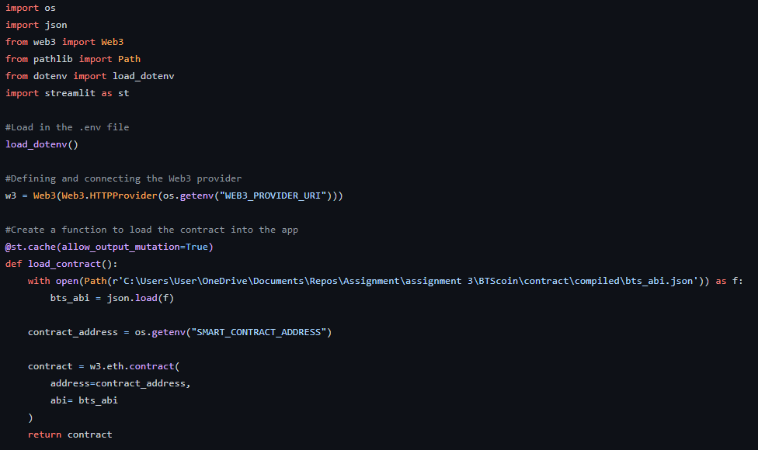
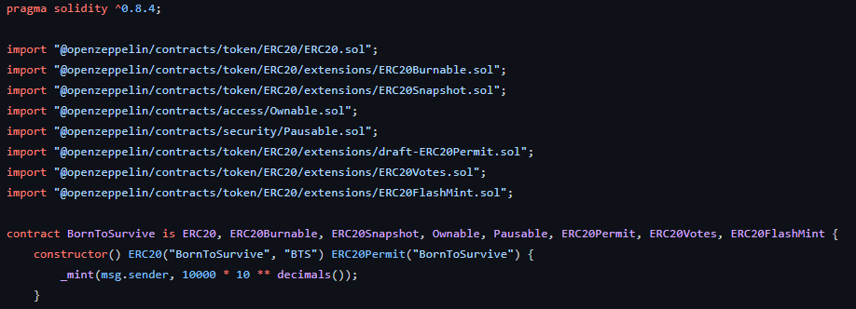
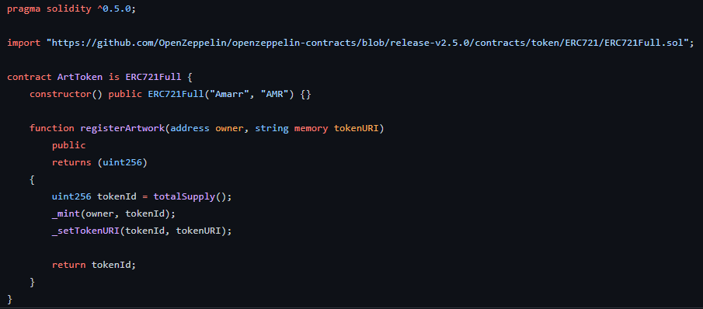
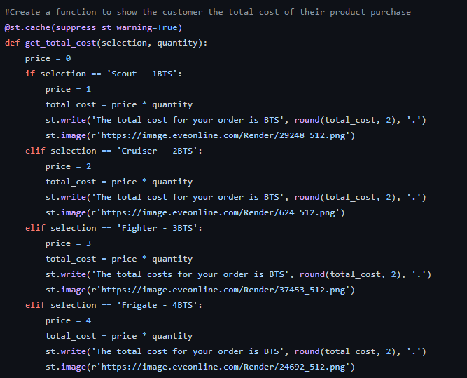
Coding
ERC20 - Coding
ERC721 - Coding
NFT Marketplace
Notes:
we used openzepline for ERC721 because it is widely used and easy to operate.

Slide 9
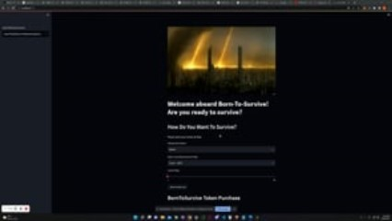
Market Place Demo
Notes:
Visual Code – and ??

Slide 10



Next steps
Interoperatability
Metaverse
Social Media
Make game available in other platforms / Blockchains
We want to make BTS a virtual world for players and investors to create and build
Make NFTs available in Social Media
Notes:
We believe we have a great concept and product, with time – we would want to take it a new level
Interoperatability – we want to make game available on other platforms, Mobile apps and other blockchains. For a Blockchcain game to be completely universal – it needs to be interoperatble and should be confined to one platform
Metaverse – we see this as a virtual world, and want to give players and investors opportunity to be able to build and create a unique universe within.
Social Media friendly – Make NFTs compatible to be displayed on social medias like Facebook. Twitter and Instagram
In future, we would want BTS to be a Sidechain or Layer 2

Slide 11
SUMMARY
Blockchain games are the future of gaming.
Notes:
Although, still at a nascent stage, in not too distinct future, more and more game studios are going to bet big in the space.
We believe, Blockchain enabled NFT games would be opportunities for brands (like Nike and Adidas) to advertised their products – wherein they can bring in their products into the game in the form of NFTs. - how cool would it would be to win in-game ‘Nike’ NFT and get a pair of shoes delivered to your doorstep as a reward.
It will change the way the gaming community plays, consumes, interacts and will add a tremendous amount of value to everyone involved. Welcome to the future of gaming.

Slide 12
THANK YOU

